Slide 1
Capacity Building in CDD Programs
Manoj Nath,
March 21, 2017

Slide 2
Country Programs in Focus
Indonesia
East-Timor
Philippines
Myanmar
Over 15 years
Less than 5 years

Slide 3
Local CB - Content, Methods & Delivery
Courses
  Basic Course – CDD and OM for all
  Thematic courses – Engineering, Finance, Social Accountability/GHM… for groups
  Tactical Inputs – Coaching/Mentoring, Remedial Courses… targeting gaps
Methods
  Adult learning
  Participatory
  Demonstration and practice
Delivery
  Led by TA with participation of Government Staff
  Engaging service providers (NGO, Government and Private) – More for thematic.
  Alignment with Government Systems – need to take the last mile

Slide 4
Institutional systems and capacity
Human Resources Implications (size of the organizations and performance management)
Public Finance Management and delivery implications (Banking, fund flow, reporting)
Infrastructure (local capacity building, new way of doing things…knowledge building).
Accountability (Citizen-Government interface)

Slide 5
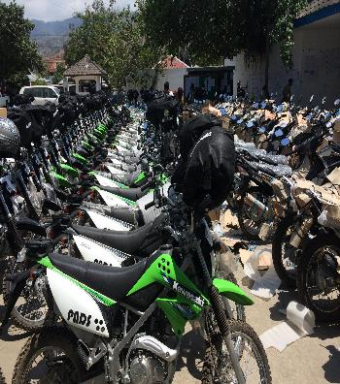
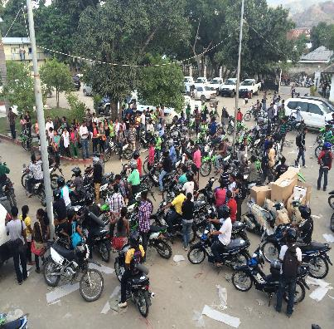
How does the Organization Change?

Slide 6
WB 2012; Implications for new programs…
“……project designers should be clear what their project objectives are and what can realistically be achieved, especially on the governance and social capital front…..”
“Teams should work with the government to develop clearer roadmaps for institutional and governance reform”.
“…..institutional sustainability is important as well as linkages with government agencies and private sector actors to sustain investments”.

Slide 7
What have we learnt?
Good Practices and Challenges

Slide 8
Good Practice –Local Capacity Building
A
A dedicated training Team with TA support (Quality and locally tested materials).
B
Involvement of relevant actors/field practitioners & partners from the beginning.
C
Demonstration, practice and Coaching.

Slide 9
Who are the Actors & partners?
Project
National Training Accreditation Agencies
Sector Ministries
Training Service Providers
Design and Development Team
Field Practitioners

Slide 10
Good Practice - Targeting Institutional Change
Training of Local Trainers from the beginning– foundation to human and institutional capital development.
Managing the entire process and not the event: targeting performance on ground with upfront investment.
A unique coaching and mentoring strategy (Monitoring with immediate targeting of issues at all levels) – Evolving Role.
Mainstreaming good practices and lessons to bring policy and practice improvement.

Slide 11
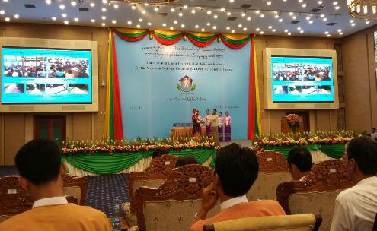
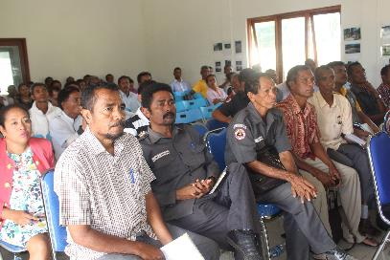


Slide 12
Challenges – Policy and implementation
CDD takes off with a well designed approach – OM, ToT, Annual Cycle Implementation.
Pressure on CDD because of its scale and influence – probably the only model with assured annual support managed by trained village teams with accountable systems and supervision from Facilitators:
  Additional programming for expansion.
  Implications on OM and Training Manuals.
  Pressure on CFs/TFs – Delivery Vs capacity building.
  Compromising the original ‘simplicity’ or intent

Slide 13
Challenges – Sustaining performance improvement
  Maintaining rigor in the training system.
  Institutionalizing CDD systems in the Organization (HR and PFM systems).
  Sustaining the investment on facilitation and training.
  Pressure of scaling up.
  Institutional systems to regulate standards and certification.
  Training M&E –targeting institutional systems and performance

Slide 14
Sustaining systems and performance
National Govt
National Govt
Organizational systems
Local Govt
Local Govt
Program systems
Variations between CDD programs
Variations between sector programs

Slide 15
Looking Ahead – CB for Building Institutions.
  CB/Training design - part of Program Design
  Upfront and continuous investment -Maintain the rigor
  Alignment with Organizational/Govt. Systems
  Sector Coordination and buy in for collective responses for Local Development.
  Institutionalization – Local reforms & National Policy dialogue.
  Outcome monitoring.

Slide 16
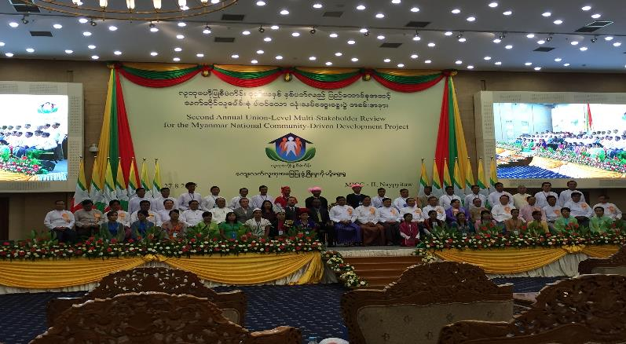
Thank You

