Slide 1
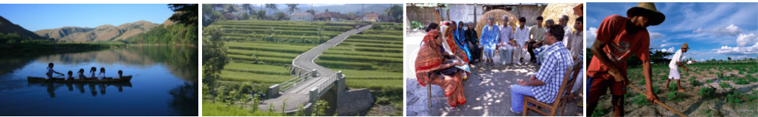
Community-Driven Development
An Introduction
[External] Updated December 2016

Slide 2
What is Community-Driven Development (CDD)?
Community-Driven Development (CDD) is an approach to local development that gives control over planning decisions and investment resources to community groups.
Community
Lowest level where common “public” purpose is defined – sharing an interest in and are affected by basic services
Driven
Controlled by – ideally more than consultation and participation… empowerment
Development
Social and economic public goods; local infrastructure and basic social services; individual household transfers where targeting can best be done by community; private goods - livelihoods and income generation

Slide 3
What are the general principles of CDD?
Transparency
Participation
Local Empowerment
Greater Downward Accountability
Enhanced Local Capacity

Slide 4
CDD programs generally include these features:
Community Focus
Participatory Planning
Participatory Monitoring
Community involvement in implementation and O&M
Community Control of Resources

Slide 5
Why is CDD important?
CDD improves development through increased:
Efficiency
Matching resources to needs
Equity
Getting resources to the poor more effectively
Empowerment
Communities have greater voice and choice
Reducing corruption and leakages
Better targeting excluded groups
Enhanced accountability, transparency and participation

Slide 6
When to use CDD?
CDD is most successful when:
Public Services or Markets Absent / Non-Functional
Local Institutions Non-Representative / Non-Responsive to Citizen Needs
Nascent Decentralization

Slide 7
Some situations like this include:
Political Transitions
Post-Conflict Reconstruction
Post-Disaster Contexts

Slide 8
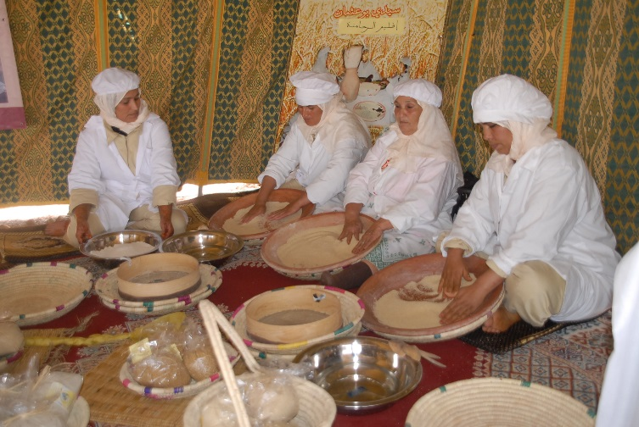
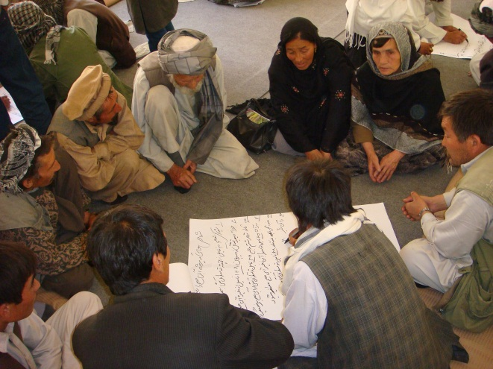
Opportunities
CDD is popular amongst a wide variety of government clients:
MICs – reaching “the last mile,” which include lagging regions, pockets of poverty, hard-to-reach marginalized communities
LICS/FCS – where government administrative capacity is low and there are difficulties with service delivery
Disaster risk mitigation and reconstruction
Morocco INDH
Afghanistan NSP

Slide 9
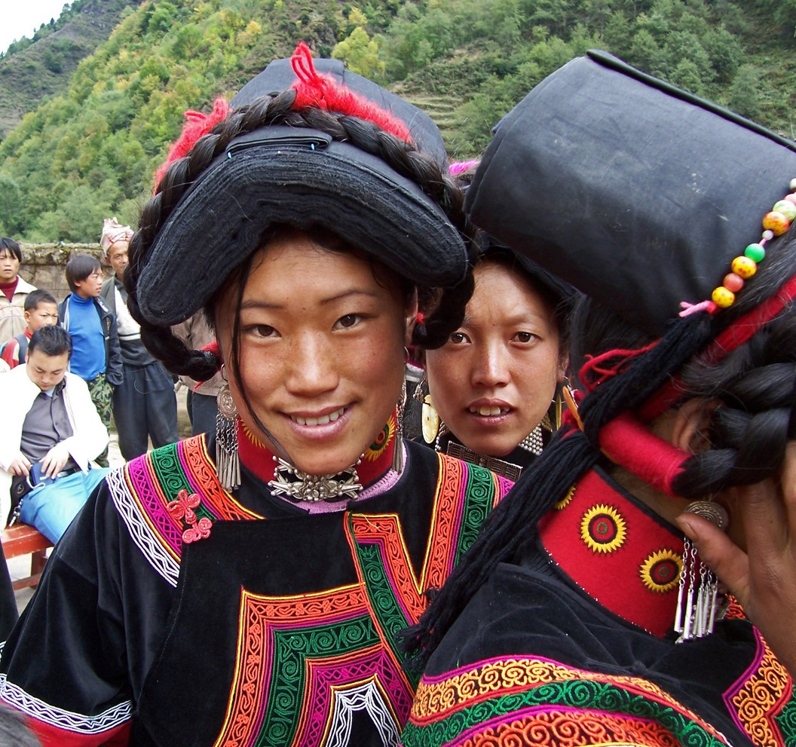
Example: CDD and Indigenous Peoples
Indigenous peoples number more than 350 million worldwide
Among the most disadvantaged – representing roughly 4.5 percent of the global population but more than 10 percent of the poor
CDD reaches “the last mile” that often include indigenous peoples communities
Vietnam, Bolivia, Laos, and Nepal, among other countries, have CDD programs assisting indigenous peoples communities

Slide 10
What does CDD finance?
CDD projects are often used for these purposes:
community infrastructure such as rural roads, water, education, or health
common property resource management such as forestry, fisheries, and water supply
micro-enterprise development or cooperatives
local governance and decentralization support
the provision of goods and services that are small-scale, not complex, and require local cooperation
Building capacity of communities and government

Slide 11
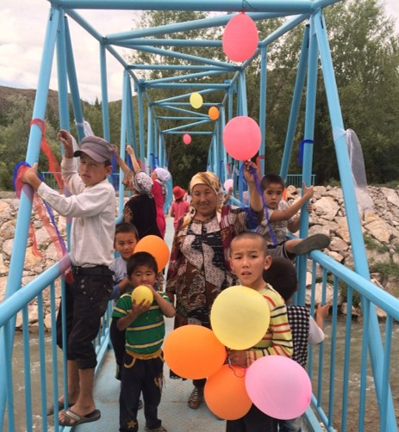
World Bank CDD Portfolio
(as of July 2016)
177 active projects, of which 77% are in IDA or IDA/Blend countries
In 73 countries, of which 22% are FCV.
$2.4 billion new lending in FY’16
$17.3 billion in total active financing*
Averaging $2.8 billion/year for past 10 years; 7.1% of overall Bank lending
* Excluding Trust Funds, Government funding and other co-financing

Slide 12
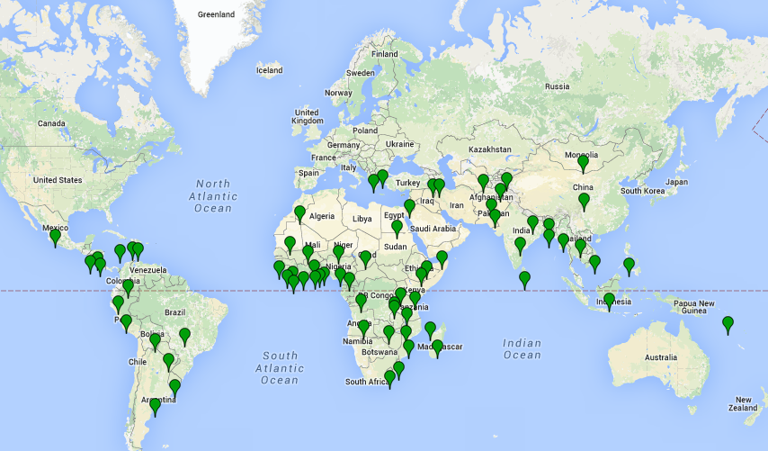
CDD is used all over the world
Europe and Central Asia
11 projects
$531 million
6 countries
Middle East and North Africa
7 projects
$353 million
4 countries
East Asia and Pacific
21 projects
$3.2 billion
8 countries
Africa
73 projects
$5.1 billion
32 countries
South Asia
41 projects
$6.4 billion
7 countries
Latin America and the Caribbean
24 projects
$1.7 billion
15 countries
Current as of July 2016

Slide 13
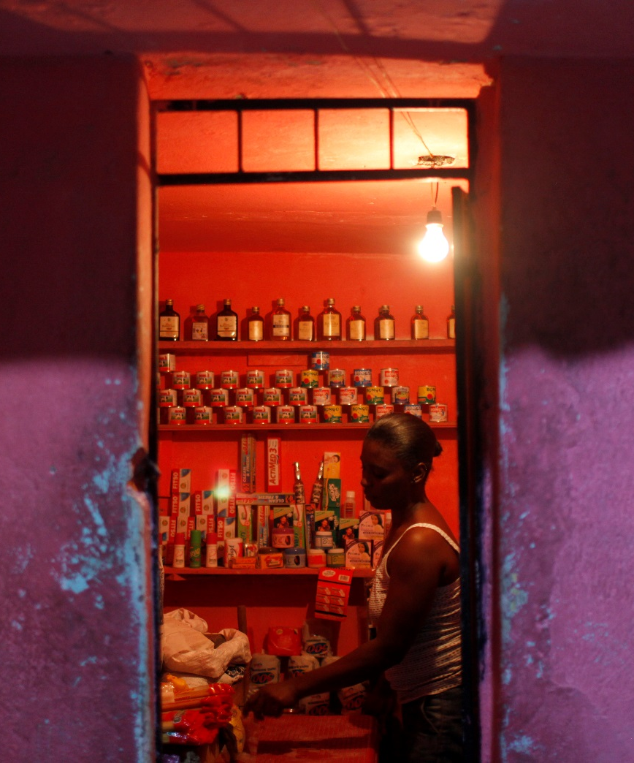
Demonstrated Impacts of CDD Programs
Positive economic welfare (income and consumption) outcomes in several programs
Significant improvements in education, health, and drinking water outcomes
Generally reaching more poor than non-poor households
Effective in delivering services quickly in post-conflict settings
Participation improves construction quality, maintenance, and lowers unit costs

Slide 14
Select examples of results on poverty and cost effectiveness
Poverty reduction/Consumption impacts:
Indonesia: 11 percent increase in consumption among poor households
India (Andhra Pradesh): 26 percent increase in household assets
Senegal: 65 percent increase in household expenditure
Cost effectiveness:
Philippines, Indonesia, and Nepal: between 13 to 39 percent lower costs of infrastructure than central government depending on the type of investments
Service delivery:
Nicaragua: Net primary enrollment rates was 5 to 10 percent higher in social funds than in non-social fund communities
Zambia: Increased use of primary health facilities compared with control
Bolivia: Share of women receiving prenatal care and the share of attended births increased significantly

Slide 15

How else does the Bank support CDD?
The CDD Community of Practice (CoP) is one of the World Bank’s largest CoPs and has approximately 770 members, with 35% outside the World Bank, including academics, international development partners, and non-governmental organizations
The CDD Global Solution Group (GSG), the Bank-internal community focusing on CDD, has approximately 335 members and is also one of the World Bank’s largest
Both the CDD CoP and GSG support research and innovation related to CDD; function as a resource center for CDD practitioners; facilitate the exchange of ideas, knowledge, and learning; and develop CDD staff skills

Slide 16
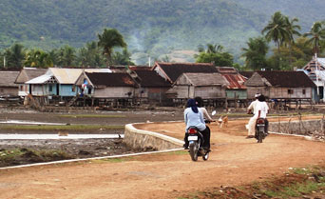
Indonesia: National Program for Community Empowerment in Rural Areas (PNPM Rural)
Background
PNPM Rural I to PNPM Rural V: 2008-2016
Active WB CDD financing: $650 million
Total program value: $7 billion (WB and Govt of Indonesia, 2016 funds)
Outputs
Builds on previous work by the Kecamatan Development Program, 1998 – 2008
The current phase of PNPM aims to reach 40 million beneficiaries across 73,000 villages.
PNPM in total has built and rehabilitated more than 135,000 km of roads, approximately 18,500 bridges, around 60,000 irrigation and clean water systems, as well as 43,000 schools and 14,000 health facilities
Generated more than 65 million labor days for poor villagers
Poor households experienced a nearly 12% increase in consumption
A special program for health and education resulted in decreases in malnutrition, improvements in maternal and child healthcare, and increases in primary school participation rates

Slide 17
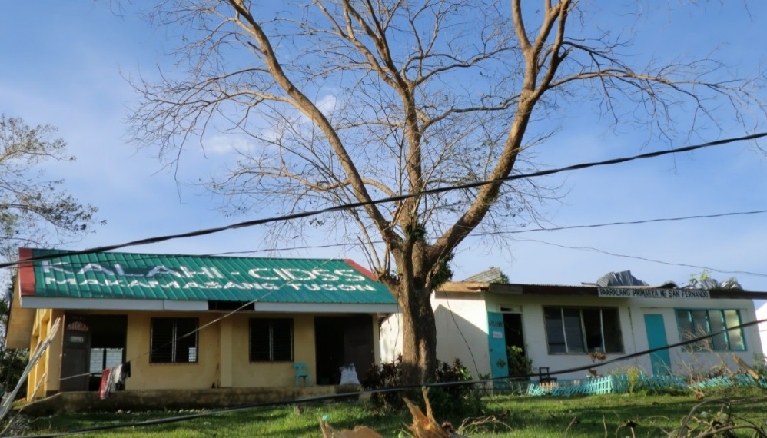
Philippines: the National CDD Project (KC-NCDDP)
Background
KC-NCDDP: 2014 - 2020
Active WB CDD financing: $478 million
Total program value: $1.1 billion (WB, Asian Development Bank, DFAT, Govt of Philippines)
Outputs
Builds on the Kalahi-CIDSS program, 2002 - 2014
Targets 8.4 million beneficiaries in the poorest provinces and municipalities of the Philippines
Based on 2012 Impact Evaluation of Kalahi-CIDSS
8,600 subprojects completed for water systems, school buildings, day care centers, health stations, farm-to-market roads, irrigation canals, etc.
A 5 percent increase in household access to safe water
Improved road access to municipal centers
Increased community trust and participation in village assemblies

Slide 18
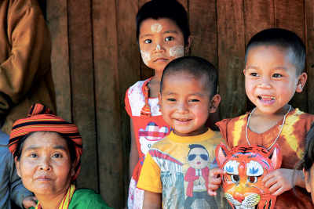
Myanmar: National CDD Project
Background
Myanmar NCCDP: 2012 - 2021
Active WB CDD financing: $480 million
Total program value: $554 million (WB, Govts of Japan and Italy)
Outputs
In the first two years, communities built or rehabilitated more than 500 schools, constructed over 500 km of footpaths and access roads, and jointly designed and implemented more than 2,100 subprojects.
Over 5,000 subprojects are expected to be constructed as part of the current community cycle.
The project to date has created more than 500,000 person days of labor.
Participation and satisfaction rates remain high; the project’s grievance handling mechanism has fielded over 1,000 inquiries, with more than 90% of these resolved within two weeks.

Slide 19
Afghanistan: National Solidarity Program (NSP)
Background
NSP: 2003 - 2017
Active WB CDD financing: $40 million
Total program value: $2.5 billion (WB, ARTF, JSDF, Govt of Afghanistan, and other bilateral donors)
Outputs
(based on 2014 Impact Evaluation)
From 2003 to 2015, 33,000 communities have been mobilized and Community Development Councils elected, $1.4 billion in block grants disbursed for more than 81,000 rural infrastructure subprojects
Increased school attendance and quality of education for girls
15% increase in the use of protected water sources, 5% reduction in the time households spend collecting water,26% increase in electricity usage
Indirect impacts of increased access to education, health care and counseling services for women, although NSP does not usually fund such services

Slide 20
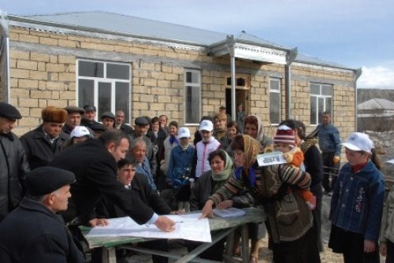
Azerbaijan: Rural Investment Projects (AzRIP)
Background
AzRIP: 2004 - 2018
Active WB CDD financing: $76.4 million
Total program value: $140 million (WB and Govt of Azerbaijan)
Outputs
The project, now in its second phase, is expected to reach more than 3.5 million beneficiaries in 1,800 poor rural communities across the country
Travel time to secondary schools reduced by 47% and to markets by 26%
Primary school enrollment increased by 25%
60% increase in volume of agricultural products being transported to markets by farmers; 20% higher prices on produce for farmers
Rehabilitation of irrigation systems has increased average productivity by approximately 30%

Slide 21
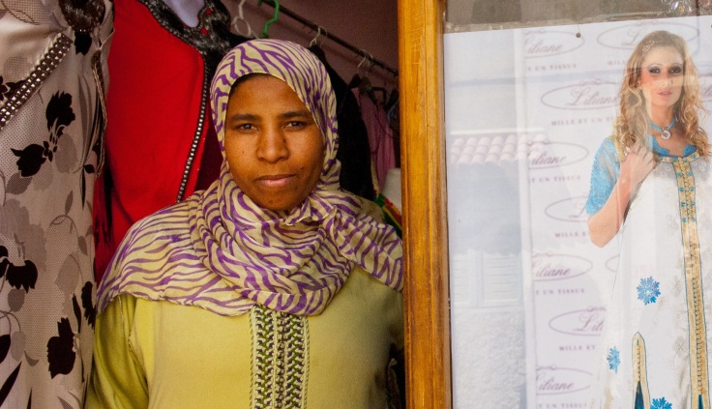
Morocco: National Initiative for Human Development (INDH)
Background
INDH: 2005 – 2016
Active WB CDD financing: $300 million
Total program value: $2.1 billion (WB and Govt of Morocco)
Outputs
As of 2014, >22,000 sub-projects financed, reaching 5 million beneficiaries, or approximately 50% of the population
Increased access to improved water supply in targeted rural communes
80% of girls in project-supported dormitories graduating to the next grade; 62% of households and 60% of women report increased access to basic infrastructure
46% of households reported improved livelihoods
Women’s participation: 17% in committees, 16% in facilitation teams, 35% of income-generation (IG) beneficiaries
Youth participation: 7% in committees, 38% IG beneficiaries

Slide 22
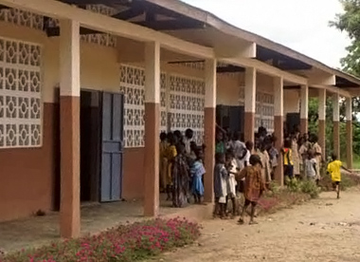
Benin: National CDD Support Project (PNDCC)
Background
PNDCC: 2004 – 2012
WB CDD financing: $59.3 million
Total program value: $77 million (WB and Govt of Benin)
Outputs
1,518 communities covered (i.e., 40 percent of the communities in Benin) using CDD to improve the access of the poorest communities to basic social and financial services
Sub-projects completed included 3,170 classrooms, 144 health centers, and 101 water and sanitation systems.
158,500 students enrolled in project schools (i.e., 10 percent of total primary school enrollment in the country)
23,000 people have gained access to an improved water source
38,000 people (77 percent women) have gained access to micro-finance services
A follow-up program for “Decentralized Community Driven Services”, worth US$76 million, is under implementation and seeks to mainstream CDD approach for basic services

Slide 23
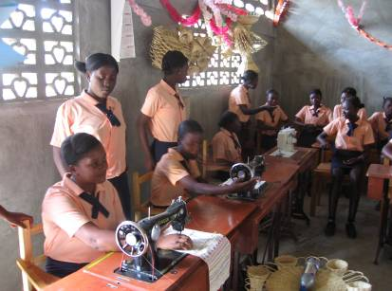
Haiti: Participatory Rural Community Development Program (PRODEP)
Background
PRODEP: 2005 – 2013
WB CDD financing: $48.2 million
Total program value: $72.6 million (WB and Caribbean Development Bank)
Outputs
1,700 subprojects financed including infrastructure (roads, irrigation, electricity); productive (agro-processing, community stores, agriculture-livestock); and social (community centers, schools, clinics; vocational training centers, etc.)
1.6 million people with improved access to basic infrastructure across 59 municipalities
Enhanced social capital through strengthened people’s participation in democratic processes, better trained community-based organizations (CBOs), and increased women involvement
Capacity building and training for more than 3,500 CBOs

Slide 24
Resources
For more information on CDD, visit the World Bank’s CDD page at http://www.worldbank.org/en/topic/communitydrivendevelopment
The CDD secretariat at the World Bank maintains and updates a library of useful materials for implementing CDD programs, including operational and knowledge resources, terms of reference, and a roster of CDD consultants.
For questions of assistance, contact us at cddgsg@worldbank.org

Slide 25
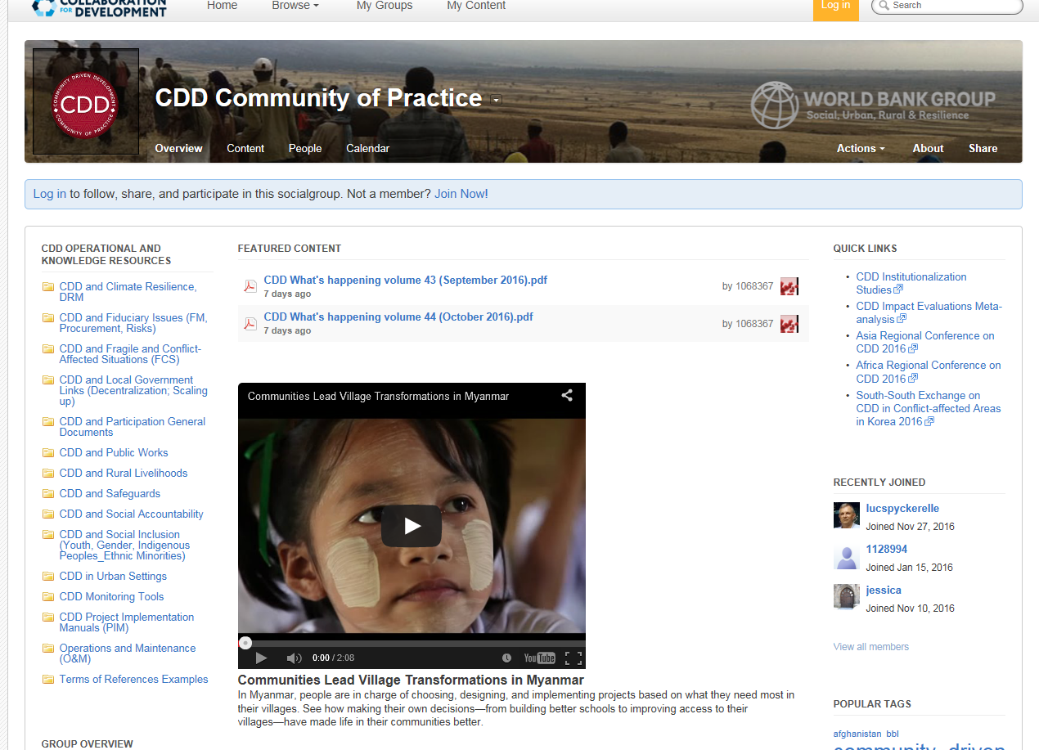
Collaboration 4 Development (C4D)
Externally accessible site aiming to enhance knowledge sharing with government teams and other development partners working on and interested in CDD!
Visit it at https://collaboration.worldbank.org/groups/community-driven-development-global-solutions-group

Slide 26
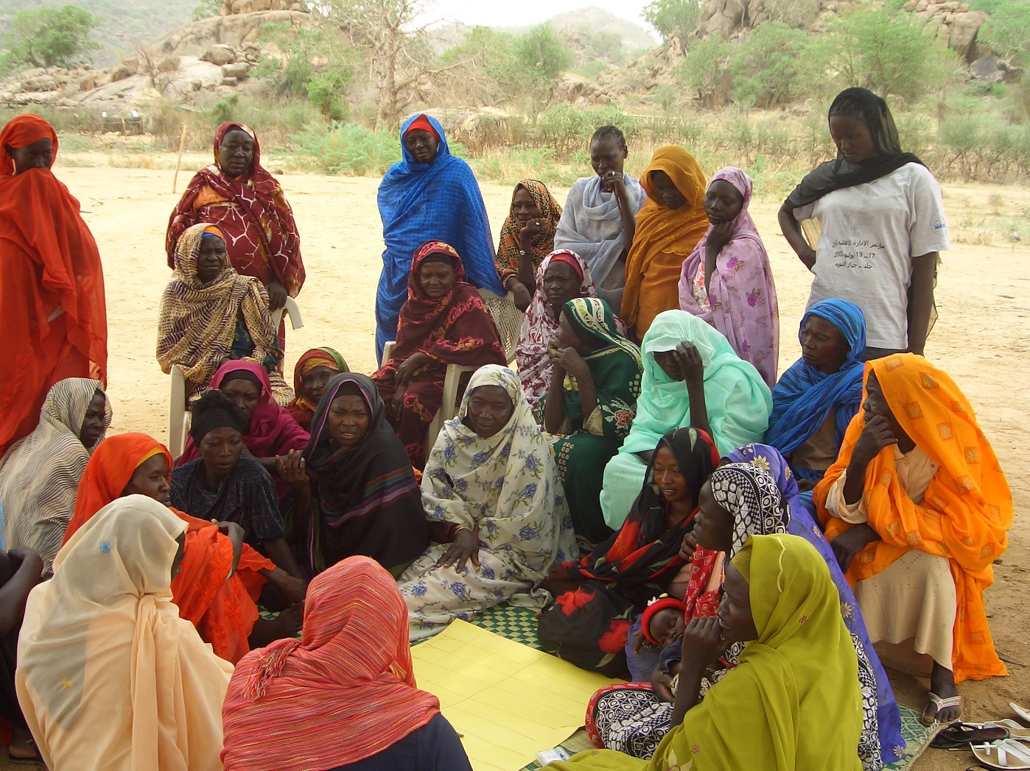
Questions?

